Slide 1

DEFENCE SERVICES ACADEMY
Ph.D. (10th Batch) Computer Science
DEFENSE
DEPARTMENT OF COMPUTER SCIENCE

Slide 2
EFFICIENT LOCATION BASED SERVICES SYSTEM USING PROXIMITY DETECTION AND PREFERENCE TREE MATCHING ALGORITHMS IN ANDROID PLATFORM
Presented By
Major Ye Zaw Myint
Ph.D. (10th Batch)
Supervisor Major Soe Thant
Co-supervisor Major Aung Winn Htut

Slide 3
Outlines
  Abstract
  Introduction
  Motivation
  Objectives
  Literature Review
  Background Theory
  Conceptual Design and implementation of Proposed System
  System Evaluation of LBS
  Conclusion and Future Work
  Steps of Research Implementation

Slide 4
Abstract
A mobile device like a smart phone is becoming one of main information processing devices.
The location service provider uses the geographical position of the user.
In our research, a framework of a Location-Based Service (ExcellentServcice) system on Android platform is presented.
The aim of this system is to exchange messages between smart phone user and location service provider.
This system provides scalable personalized location-based services to users.
To improve performance and reduce processing power, symmetry based proximity detection algorithm is proposed.
A preference tree matching algorithm is proposed by using simple tree matching.
This algorithm can match user preference query and extract optimal answers.
To evaluate the effectiveness of the system, performance evaluations are carried out on Android platform.

Slide 5
Introduction
The Location Based Service (LBS) is a kind of service derived from the ability in electronic communication.
LBS which can be defined as the application of which the service and information provided are determined.
Its service can be extended to general consumer application, in which different LBS could be provided to the consumers according to their distinct location.
LBS will play an important role in the telecommunication industry due to its ability of positioning in the mobile telecommunication, and due to the complete difference with respect to the operation interface of web service of mobile devices from that of computers, any complex application service will lead to consumer resistance.
As the result, it is necessary for the development of LBS to utilize the mobile devices effectively and to introduce the recommendation mechanism correctly.

Slide 6
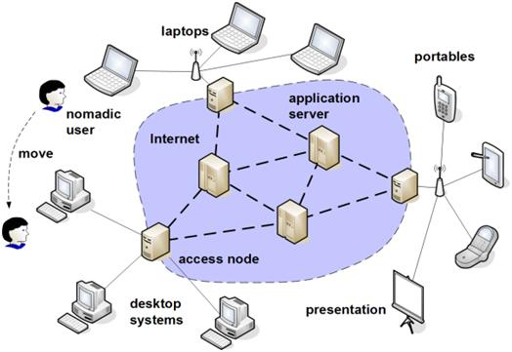
Mobile Computing
Mobile computing is a relatively new field of research.
It has expanded from being primarily technical to now also being about usability, usefulness, and user experience.
This has led to the birth of the vibrant area of mobile interaction design at the intersections between, among others.

Slide 7
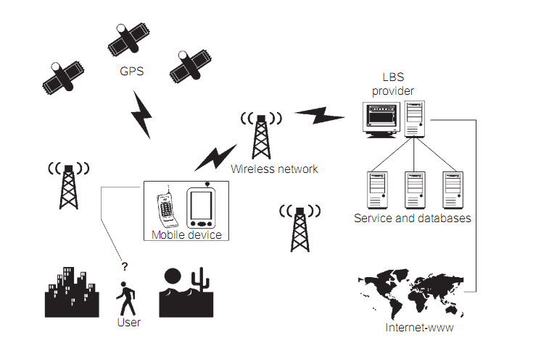
Location Based Services (LBS)
Location services can be defined as services that integrate a mobile device’s location
Location services are mainly used in three areas
The first location system in use was the satellite-based GPS as illustrated in figure,
Analysts and researchers have taken several approaches to classifying LBS applications.

Slide 8
Problem Formulation & Motivation
The main promise of location-based services is to provide new services to their customers.
Examples of these services include continuous live traffic reports, food and drink finder, and location-based advertising.
Due to the abundance of location-based data, location-based services have begun to integrate their functionality with database systems.
This research aims to raise the challenges and provide research directions to enable practical realization of preference-aware location-based services.
It aims to enhance the answer of location-based queries.
As the query answer may be returned to the users on their mobile devices with limited screen capabilities.
Therefore, it is of essence to enhance the quality of the answer and limit the answer to only those results that are of major interest to the users according to their preferences.

Slide 9
Objectives
The main objective of this research is to provide location-based services to smart phone to meet according to their preference requirements. The major objectives of this research are as follows;
To provide location based web services to smart phone users without needing to browse using browser applications
To behave as a guide for the smart phone users to provide directions and rich information
To provide scalable personalized location-based services to users based on their preferences and user desired location range
To get services which meet smart phone users’ requirements on the limited mobile screen efficiently and accurately
To provide the historical records of the registered user

Slide 10
Literature Review
LBS with GPS Positioning
K. Michael, et al, have described as GPS-based tracking system that collects the geographic co-ordinates from the GPS receiver carried by the user and transforms it to comprehensive location by using GIS software.
LBS on Android Platform
Bareth. U, Kupper. A, proposed a hierarchical positioning algorithm.
The algorithm dynamically deactivates different positioning technologies and only activates the positioning method with the least energy consumption that at the same time provides sufficient accuracy to correctly determine topological relationships.

Slide 11
Literature Review
SOAP-based Location-based Web Services
Z. Ahmad, et al, proposed a GIS Webservices architecture based on SOAP, XML and HTTP.
The proposed Webservices approach is found to be practical and promises a lowering of the entry barrier to adopt GIS for LBS development.
RESTful-based Location-based Web Services
O’ Hare, et al, proposed LBS architecture with RESTful Web Service from the perspective of service design and horizontal service integration.
The main starting point for this approach is Web Architecture and the underlying architectural style of RESTful Web Service.

Slide 12
Literature Review
LBS with MySQL Spatial Support
Di Zhou, et al, presented “Design and implementation for location-based service platform” which can bedivided into client side and server side.
Client side of this platform software is developed based on the following techniques: mobile SVG based JSR226 and JSR179 specification, Bluetooth, mobile media, map slicing, map layering, and J2ME.
Sever side is developed by XML, J2EE, and MySQL.
This platform can provide the following services: information of map segment query, shortest path to destination query by Dijkstra algorithm, bus route query, and route navigates.

Slide 13
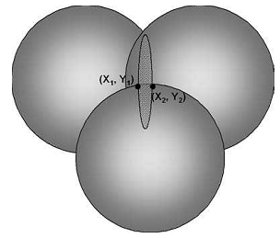
Global Positioning System (GPS)
The Global Positioning System (GPS) is a satellite-based global radio navigation system.
GPS consists of 21 satellites plus three spare ones orbiting the Earth every 12 hours.
Figure: Measurements Two Position Points Determined by the Three Satellite.

Slide 14
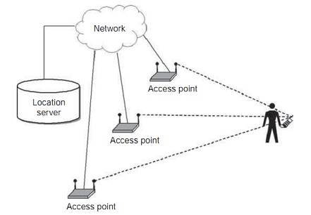
WiFi-Based Positioning Technology
WiFi-based positioning only works in areas where there is network coverage from access points and also it can work in indoor environments.
Currently, WiFi technology is widely used in offices, homes, airports, cafes, hotels and public places.
WiFi-based positioning can also be used for outdoor environments, usually in dense urban areas.
The accuracy of this method is generally not very high.
Figure: Illustration of WiFi-based Positioning

Slide 15
Context and Context-Awareness in LBS
With the fast development of wireless communication and increasing use of mobile devices, context-awareness has become an increasingly important consideration in developing systems and applications.
Being aware of the context(s) in which systems and applications are run can improve their ability to adapt and react to user situations.
Context-aware is often described as the ability to discover changes in user situations (context), being responsive to them.
In context-aware systems, contextual information can either be obtained by requiring users to enter data into the system, or can be acquired by sensing devices, monitoring patterns of use and the surrounding environment.

Slide 16
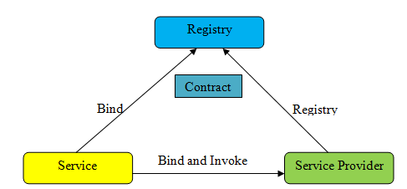
SOAP based Web Services
The three core technologies of SOAP based Web Services: SOAP, WSDL and UDDI are used as a direct application of the SOA find-bind-execute cycle as shown in figure.
Figure: SOA Find-Bind-Execute Cycle.

Slide 17
REST based Web Services
The idea of Web Services based on the Representational State Transfer (REST) principle is to directly rely on the technologies already provided by the World Wide Web, rather than creating new ones. The key technologies for REST are as follows;
  Uniform Resource Identifiers (URIs)
  HTTP
  XML
REST directly relies on higher level protocols for providing a Service Oriented Architecture.

Slide 18
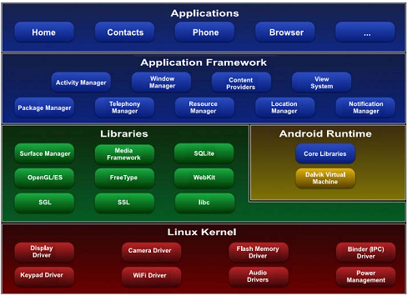
Android
Android is a mobile operating system running on the Linux kernel.
It allows developers to write managed code in the Java language.
Following figure displays the main architecture of the Android operating system.
Figure: Major Components of the Android Operating System

Slide 19
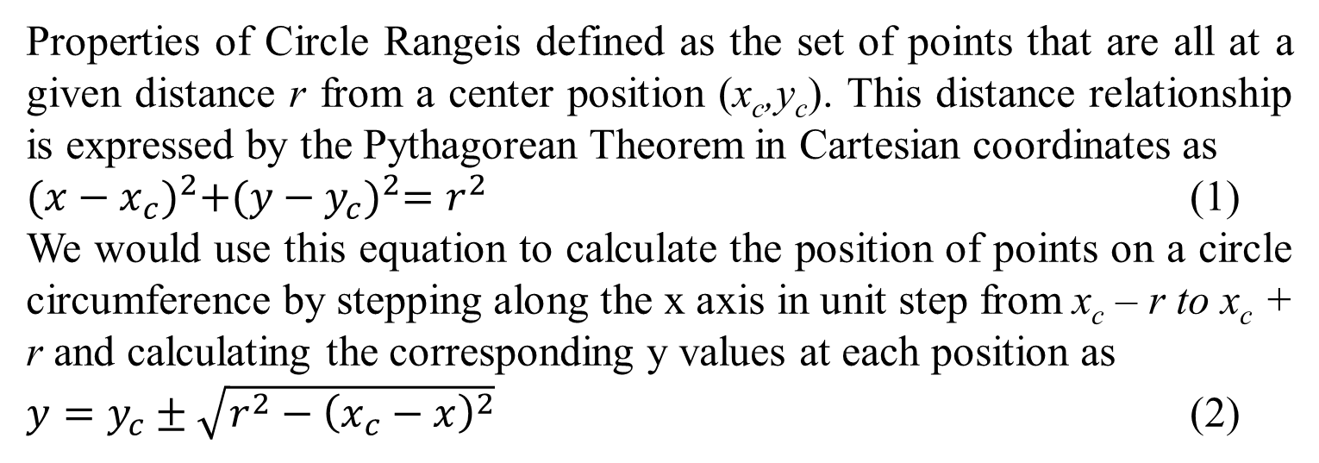
Range Query Generating Algorithm
Properties of Circle Rangeis defined as the set of points that are all at a given distance r from a center position (x_{c},y_{c}). This distance relationship is expressed by the Pythagorean Theorem in Cartesian coordinates as
${(x−x_{c})}^{2}+{(y−y_{c})}^{2}=r^{2}$ (1)
We would use this equation to calculate the position of points on a circle circumference by stepping along the x axis in unit step from x_{c} – r to x_{c} + r and calculating the corresponding y values at each position as
$y=y_{c}±\sqrt{r^{2}−{\left(x_{c}−x\right)}^{2}}$ (2)

Slide 20
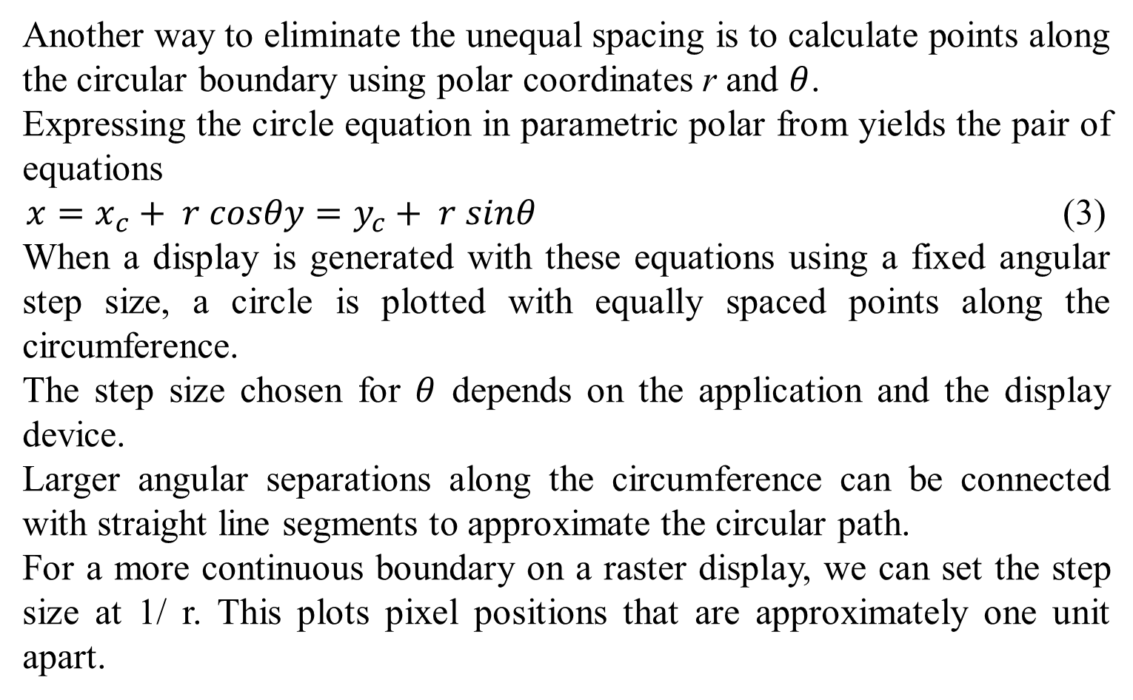
Range Query Generating Algorithm (Cont’d)
Another way to eliminate the unequal spacing is to calculate points along the circular boundary using polar coordinates r and $θ$.
Expressing the circle equation in parametric polar from yields the pair of equations
$x=x_{c}+ r cosθy=y_{c}+ r sinθ$ (3)
When a display is generated with these equations using a fixed angular step size, a circle is plotted with equally spaced points along the circumference.
The step size chosen for $θ$ depends on the application and the display device.
Larger angular separations along the circumference can be connected with straight line segments to approximate the circular path.
For a more continuous boundary on a raster display, we can set the step size at 1/ r. This plots pixel positions that are approximately one unit apart.

Slide 21
Adaption of Bresenham’s Line Algorithm
Bresenham’s line algorithm for raster displays is adapted to circle generation by setting up decision parameters for finding the closet pixel to the circumference at each sampling step.
Bresenham’s circle algorithm avoids these square root calculations by comparing the squares of the pixel separation distances.
A method for direct distance comparison is to test the halfway position between two pixels to determine if this midpoint is inside or outside the circle boundary.
This method is more easily applied to other conics; and for an integer circle radius, the midpoint approach generate the same pixel positions as the Bresenham circle algorithm.
Also, the error involved in locating pixel positions along any conic section using the midpoint test is limited to one-half the pixel separation.

Slide 22
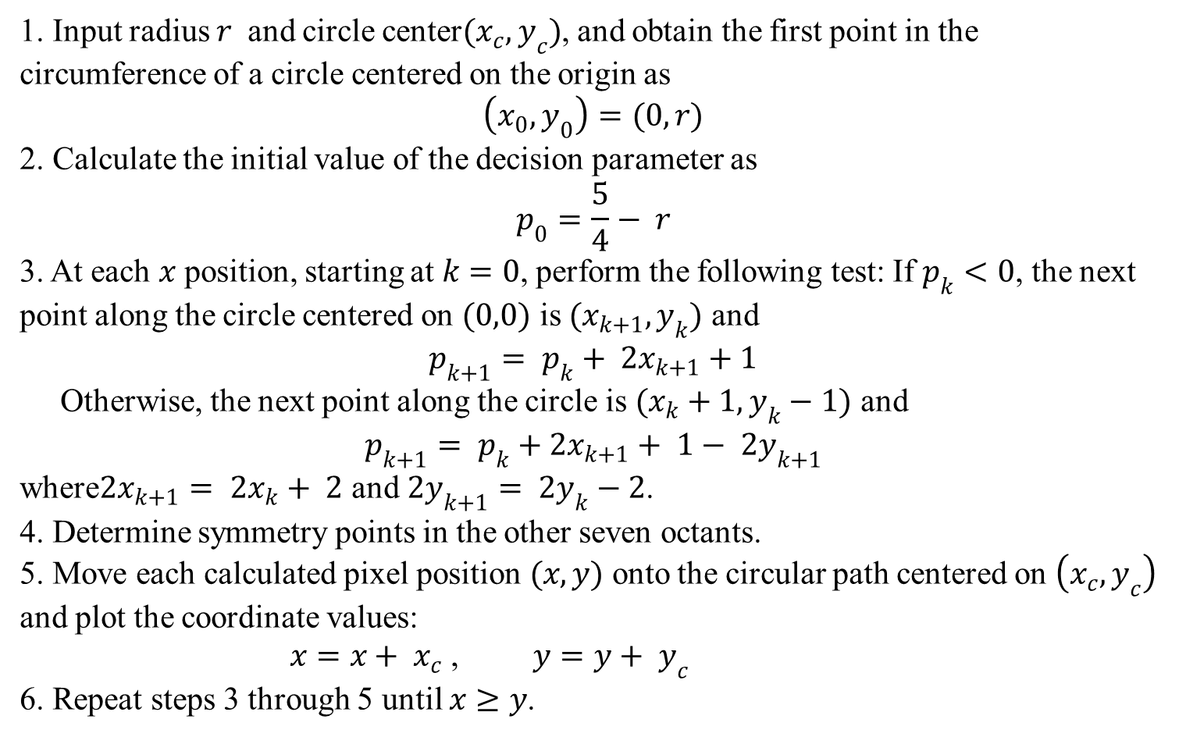
Proximity Detection Algorithm with Symmetry Approach
1. Input radius $r$ and circle center$(x_{c}, y_{c})$, and obtain the first point in the circumference of a circle centered on the origin as
$$\left(x_{0},y_{0}\right)=(0, r)$$
2. Calculate the initial value of the decision parameter as
$$p_{0}=\frac{5}{4}− r$$
3. At each $x$ position, starting at $k=0$, perform the following test: If $p_{k}<0$, the next point along the circle centered on $(0,0)$ is $(x_{k+1}, y_{k})$ and
$$p_{k+1}= p_{k}+ {2x}_{k+1}+1$$
Otherwise, the next point along the circle is $(x_{k}+1, y_{k}−1)$ and
$$p_{k+1}= p_{k}+{2x}_{k+1}+ 1− {2y}_{k+1}$$
where${2x}_{k+1}= {2x}_{k}+ 2$ and ${2y}_{k+1}= {2y}_{k}−2$.
4. Determine symmetry points in the other seven octants.
5. Move each calculated pixel position $(x, y)$ onto the circular path centered on $\left(x_{c}, y_{c}\right)$ and plot the coordinate values:
$x=x+ x_{c}$ , $y=y+ y_{c}$
6. Repeat steps 3 through 5 until $x≥y$.

Slide 23
Process Flow of Location Range Calculation
Figure: Process Flow of the Symmetry based Location Range Calculation

Slide 24
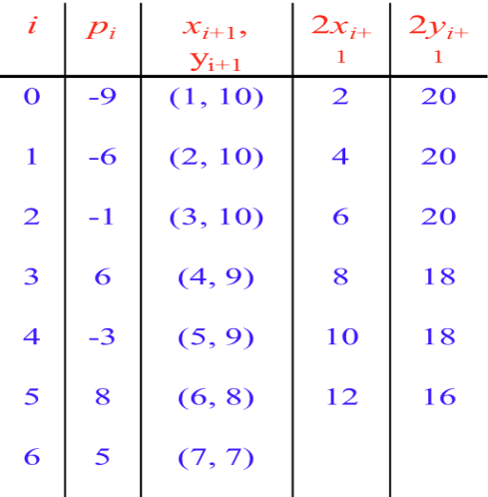
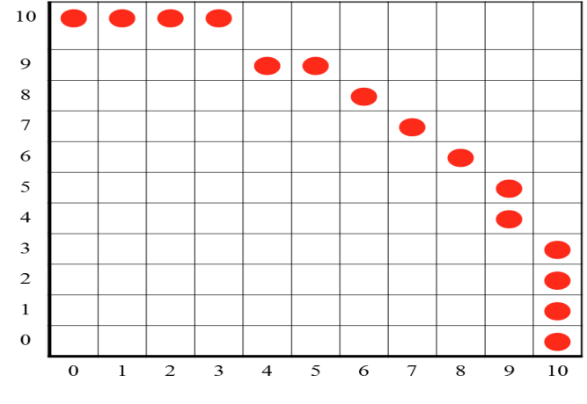
Calculated Point Positions (Solid Circle)
The point positions along a circle path within 10 Km are calculated using proximity detection algorithm and the symmetry positions in the first quadrant is shown in figure.
Figure: Calculated Point Positions (solid circle) along a Circle Path with r=10Km.

Slide 25
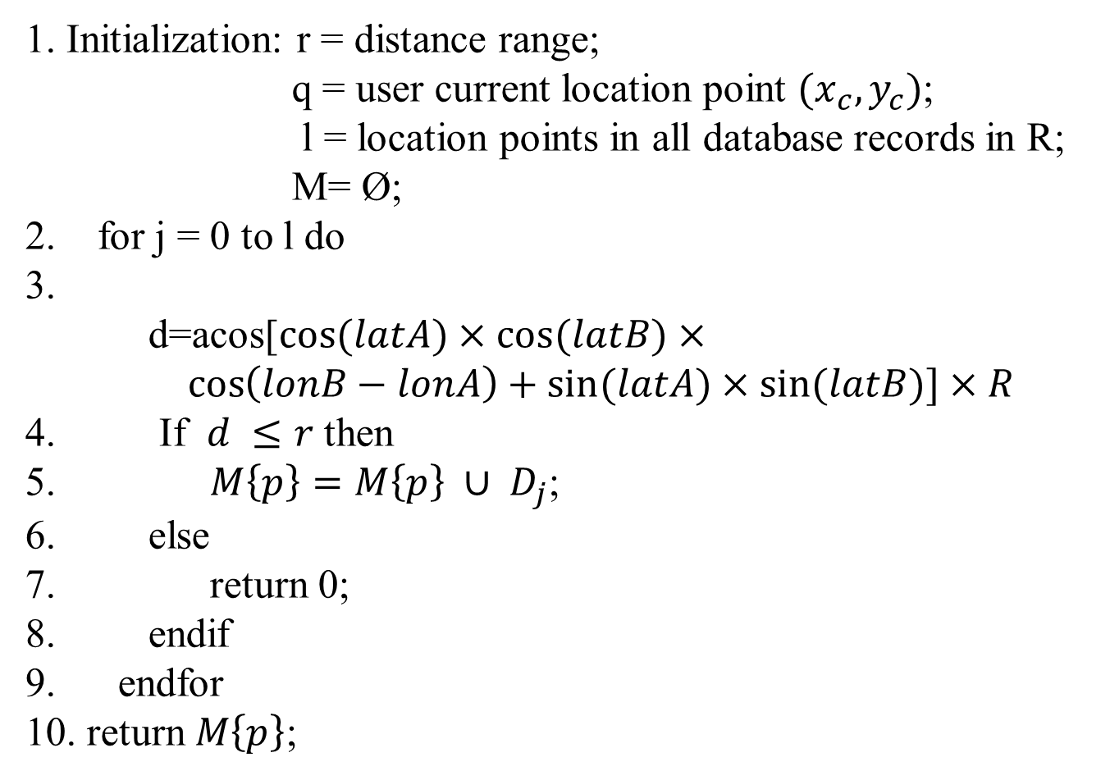
Location Range Algorithm with Distance-based Approach
1. Initialization: r = distance range;
q = user current location point $(x_{c},y_{c})$;
l = location points in all database records in R;
M= Ø;
2. for j = 0 to l do
3. d=acos[$cos⁡(latA)×cos(latB)×\cos\left(lonB−lonA\right)+sin⁡(latA)×sin(latB)]×R$
4. If $d ≤r$ then
5. $M\left\{p\right\}=M\left\{p\right\} ∪ D_{j}$;
6. else
7. return 0;
8. endif
9. endfor
10. return $M\left\{p\right\}$;

Slide 26

Preference Tree Matching Algorithm
1. Initialization : m = number of preferences in P;
l = number of database tree records in D;
R= Ø;
2. If m does not contain in l then
3. return 0;
4. else
5. for j = 1 to l do
6. r = SimpleTreeMatching ( P, $D_{j}$)
7. R{r}= R{r} U $D_{j}$
8. endfor
9. return R{r};
10. endif

Slide 27
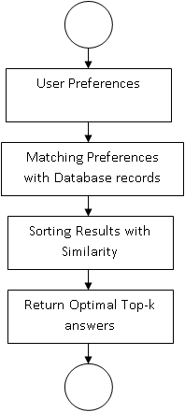
Process flow of the preference matching and filtering

Slide 28
Simple Tree Matching Algorithm
if the root of the two trees A and B contain distinct symbols then
return 0;
else m= the number of first-level subtrees of A;
n= the number of first-level substrees of B;
Initialization: M[i,0] = 0 for i = 0,………..,m;
M[0,j] = 0 for j = 0,……......,n;
for i = 1 to m do
for j = 1 to n do
M[i,j]=max (M[i,j-1], M[i-1,j], M[i-1,j-1] +W[i,j]),
where W[i,j]= SimpleTreeMatching (Ai,Bj)
endfor
endfor
return (M[m,n]+1);
Endif

Slide 29
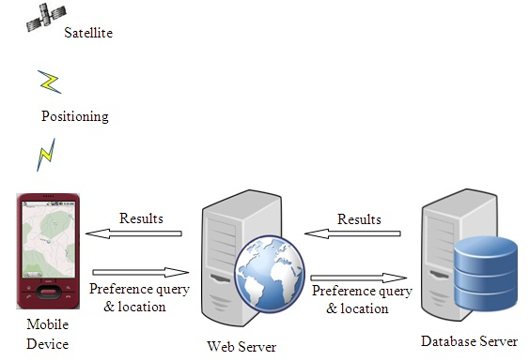
Conceptual Design of Location Based Services (ExcellentService) System

Slide 30
ES-DB Database

Slide 31
Structure of ExcellentService Software Prototype

Slide 32
Process Flow Diagram

Slide 33
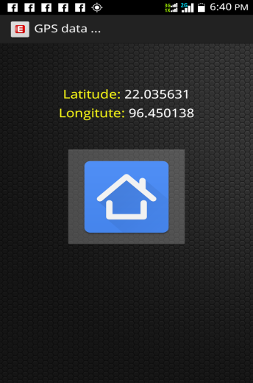
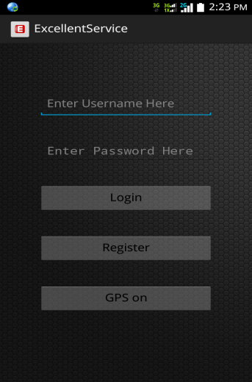
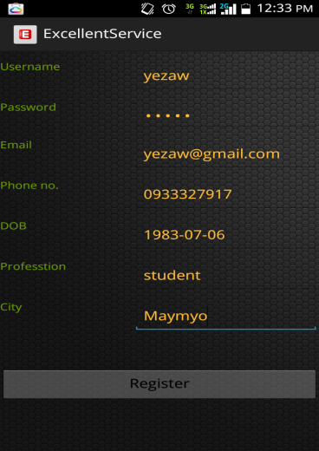
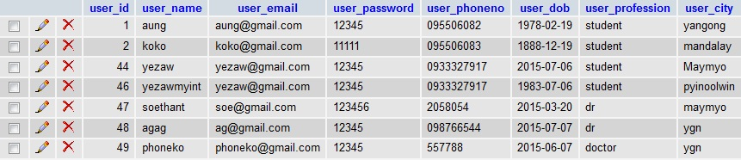
Implementation of Proposed System
Figure (a)
Figure (b)
Figure (c)
Figure (d)

Slide 34
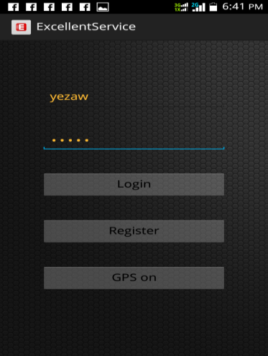
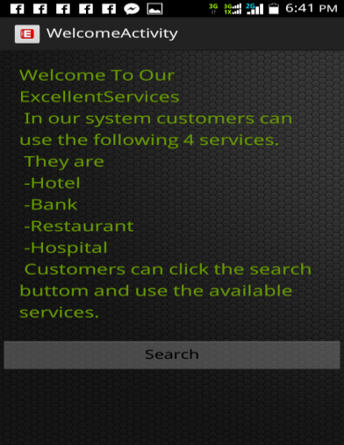
Implementation of Proposed System (Cont’d)
Figure (a)
Figure (b)

Slide 35
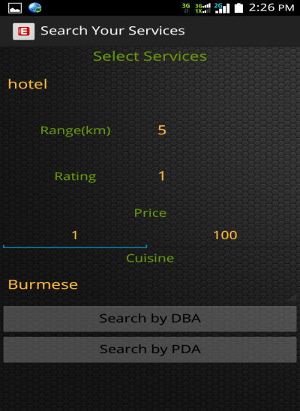
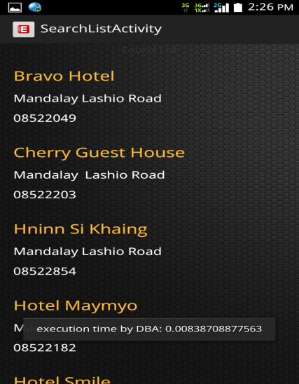
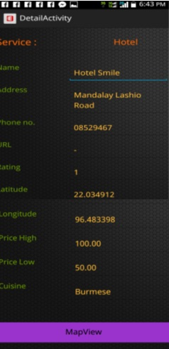
Implementation of Proposed System (Cont’d)
Figure (a)
Figure (b)
Figure (c)

Slide 36
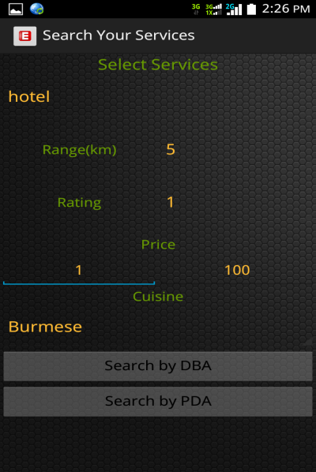
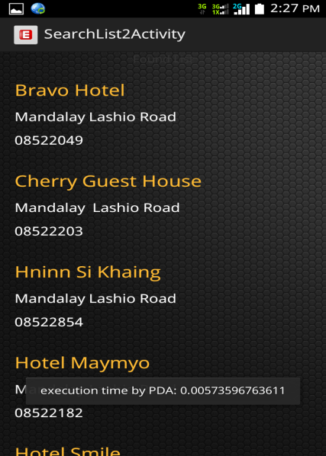
Implementation of Proposed System (Cont’d)
Figure (a)
Figure (b)
Figure (c)

Slide 37
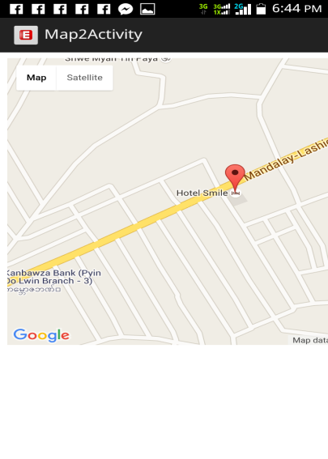
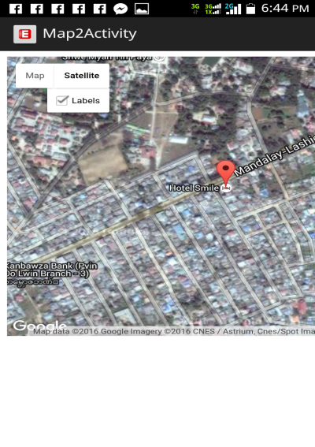
Implementation of Proposed System (Cont’d)
Figure (a)
Figure (b)

Slide 38
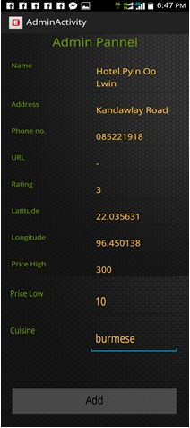
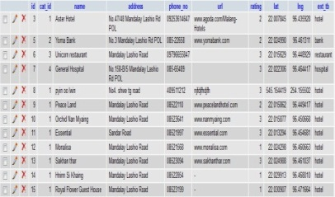
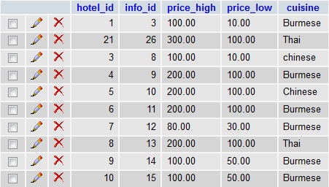
Implementation of Proposed System (Cont’d)
Figure (b)
Figure (a)
Figure (c)

Slide 39
Software/Hardware Apparatus Of LBS

Slide 40
System Evaluation Of LBS
Location Range (km) | 1 km | 3km | 5km | 7km | 10km
Execution Time PDA (ms) | 3.96 | 4.34 | 4.93 | 5.12 | 6.41
Execution Time DBA (ms) | 5.71 | 6.91 | 7.15 | 7.65 | 8.56
where, T_{p}= Processing Time
T_{s}= Start Time
T_{e}= End Time
Figure (a)
Figure (b)

Slide 41
System Evaluation Of LBS (Cont`d)
Number of records (DBA)
Location Range (km) | 1 km | 2km | 3km | 4km | 5km | 6km | 7km | 8km | 9km | 10km
Hotel | 5 | 16 | 21 | 22 | 22 | 23 | 24 | 24 | 24 | 24
Restaurant | 1 | 13 | 16 | 17 | 17 | 17 | 17 | 17 | 17 | 17
Bank | 0 | 5 | 6 | 7 | 7 | 7 | 7 | 7 | 7 | 7
Hospital | 0 | 2 | 4 | 4 | 4 | 4 | 4 | 4 | 4 | 4
Figure (a)
Number of records (PDA)
Location Range (km) | 1 km | 2km | 3km | 4km | 5km | 6km | 7km | 8km | 9km | 10km
Hotel | 2 | 15 | 21 | 22 | 22 | 23 | 24 | 24 | 24 | 24
Restaurant | 1 | 11 | 15 | 16 | 17 | 17 | 17 | 17 | 17 | 17
Bank | 0 | 5 | 6 | 7 | 7 | 7 | 7 | 7 | 7 | 7
Hospital | 0 | 2 | 4 | 4 | 4 | 4 | 4 | 4 | 4 | 4
Figure (c)
Figure (b)
Figure (d)

Slide 42
System Evaluation Of LBS (Cont`d)
Execution Time of DBA (ms)
Location Range (km) | 1 km | 3km | 5km | 7km | 10km
Hotel | 4.61 | 6.39 | 8.45 | 9.83 | 12.42
Restaurant | 4.82 | 6.18 | 7.56 | 7.92 | 11.91
Bank | 3.92 | 6.02 | 6.58 | 7.56 | 9.25
Hospital | 3.68 | 5.93 | 6.92 | 7.25 | 9.13
Execution Time of PDA (ms)
Location Range (km) | 1 km | 3km | 5km | 7km | 10km
Hotel | 3.32 | 4.85 | 6.25 | 8.45 | 10.81
Restaurant | 2.96 | 4.93 | 6.74 | 7.02 | 9.38
Bank | 3.08 | 4.61 | 5.19 | 5.92 | 8.16
Hospital | 2.54 | 4.12 | 5.01 | 5.86 | 8.01
Figure (a)
Figure (c)
Figure (b)
Figure (d)

Slide 43
System Evaluation Of LBS (Cont`d)
Execution Time of DBA (ms)
Location Range (km) | 1 km | 3km | 5km | 7km | 10km
1 User | 5.71 | 6.91 | 7.15 | 7.65 | 8.56
2 Users | 6.59 | 7.36 | 7.83 | 8.62 | 8.84
3 Users | 7.67 | 8.42 | 9.17 | 9.72 | 10.53
4 Users | 9.81 | 10.31 | 11.02 | 11.58 | 13.72
5 Users | 11.98 | 12.29 | 13.87 | 14.11 | 14.98
Execution Time of PDA (ms)
Location Range (km) | 1 km | 3km | 5km | 7km | 10km
1 User | 3.96 | 4.34 | 4.93 | 5.12 | 6.41
2 Users | 4.28 | 5.35 | 5.91 | 6.33 | 6.79
3 Users | 6.84 | 7.18 | 7.52 | 7.93 | 8.14
4 Users | 8.68 | 9.13 | 9.52 | 10.71 | 12.21
5 Users | 10.85 | 11.82 | 13.92 | 14.15 | 14.67
Figure (a)
Figure (c)
Figure (b)
Figure (d)

Slide 44
System Evaluation Of LBS (Cont`d)
Where, T_{resp} = Response Time
T_{req} = Request Time
(T_{e}-T_{s}) = Processing Time
T_{rep} = Reply Time

Slide 45
Conclusions
Providing dynamic location-based service and improving the information retrieve accuracy especially in the limited mobile screen have become the important research areas in the development of LBS.
Current location-based applications only provide services based only on the location context while ignoring various forms of user preferences.
In this thesis, we have discussed the rigidness in current location-based applications that provide services based only on the location context while ignoring various forms of user preferences and surrounding context.
To overcome such rigidness, we introduced the system architecture of a Location based Services that delivers personalized services to its customers based on the surrounding context.
LBS tailors its functionalities and services based on not only user desired location range but also the preferences of each user.

Slide 46
Conclusions (Cont’d)
The system is evaluated and analyzed based on processing and response time with DBA and PDA algorithms.
This analysis is needed to select the most appropriate implementation technology that suits limited mobile environment capabilities and to facilitate providing mobile Web Services in a continuous light weight processing manner.
According to evaluation results, we observed that PDA can compute specified location ranges nearly one-fourth times faster than distance based approach.
The system responds users request accurately by filtering with preference matching and filtering algorithm.
The system provides smart phone users with reasonable performance and suitable services to meet user’s satisfaction.

Slide 47
Limitations of Proposed Research
The first disadvantage of our research is that, it is entirely rely on the connection speed of our Myanmar’s Internet connection speed.
If the connection is not in the best condition, the GPS location point’s results will be worst.
As we mention above chapters, we are rely on the Google Map services, so our process phones must be suitable with Google Services in order to get the latest map information.
Our proposed research cannot give the direct optimized way (road map) for the user as it is not a navigation system.
For the GPS location point, the entire usage phones must have the appropriate GPS service also.

Slide 48
Further Extension
Geofencing is the next natural step of LBS. A geofence is a virtual area defined by a set of boundaries, like a leisure center area or neighborhood boundaries. This way, ExcellentService takes into account geo-content, which refers to the context that is relevant to a particular area. In this system, web services are used as the external resource for the ExcellentService. As a further extension, we can extend our web services into cloud computing platforms. Hence the advent of cloud computing in location-based services increases the user’s information retrieve capability by overcoming the mobile’s storage space and processing capability. The message can be exchanged between user and location service provider in mobile device accessing the cloud by minimizing cost, data storage and processing power. Our main goal is to provide dynamic location-based service and increase the information retrieve accuracy especially on the limited mobile screen by accessing cloud computing technology.

Slide 49
Author`s Publications
[1] Wai lin Aung, Lieutenant Commander, Ye Zaw Myint, Captain, “Web-based Intrusion Detection Systems”, Science and Technology Development Journal, Volume VI, Issue I, September 2014, Defence Services Technology Academy
[2] Wai lin Aung, Lieutenant Commander, Ye Zaw Myint, Captain, “Prevention of SQL Injection Vulnerabilities”, Science and Technology Development Journal, Volume VI, Issue I, September 2014, Defence Services Technology Academy
[3] Ye Zaw Myint, Captain, Wai lin Aung, Lieutenant Commander, “Architecture and Components of Android Operating System”, Science and Information Journal, Volume VII, Issue III, September 2015, Defence Services Academy
[4] Soe Thant, Major, Wai lin Aung, Lieutenant Commander, Ye Zaw Myint, Captain, “Approach To The Detection of Web-Based Attacks”,6th ICSE 2015,YTU
[5] Wai lin Aung, Lieutenant Commander, Ye Zaw Myint, Major, “Efficient Location Based Services System Using Proximity Detection And Preference Tree Matching Algorithms In Android Platform”, Science and Technology Development Journal, Volume V, Issue II, March 2016, Defence Services Technology Academy
[6] Wai lin Aung, Lieutenant Commander, Ye Zaw Myint, Major, “Computer Forensics အေၾကာင္းခြဲျခမ္းစိတ္ျဖာေလ့လာျခင္း”, Science and Technology Development Journal, Defence Services Technology Academy, Pending

Slide 50
Thank You
Suggestions and Comments

